Slide 1
DALLAS COMMERCIAL
CASES 2019
DAVID S. COALE
DBA Appellate Law Section Meeting
Dallas, Texas
June 13, 2019
600Commerce.com

Slide 2
600Commerce.com

Slide 3
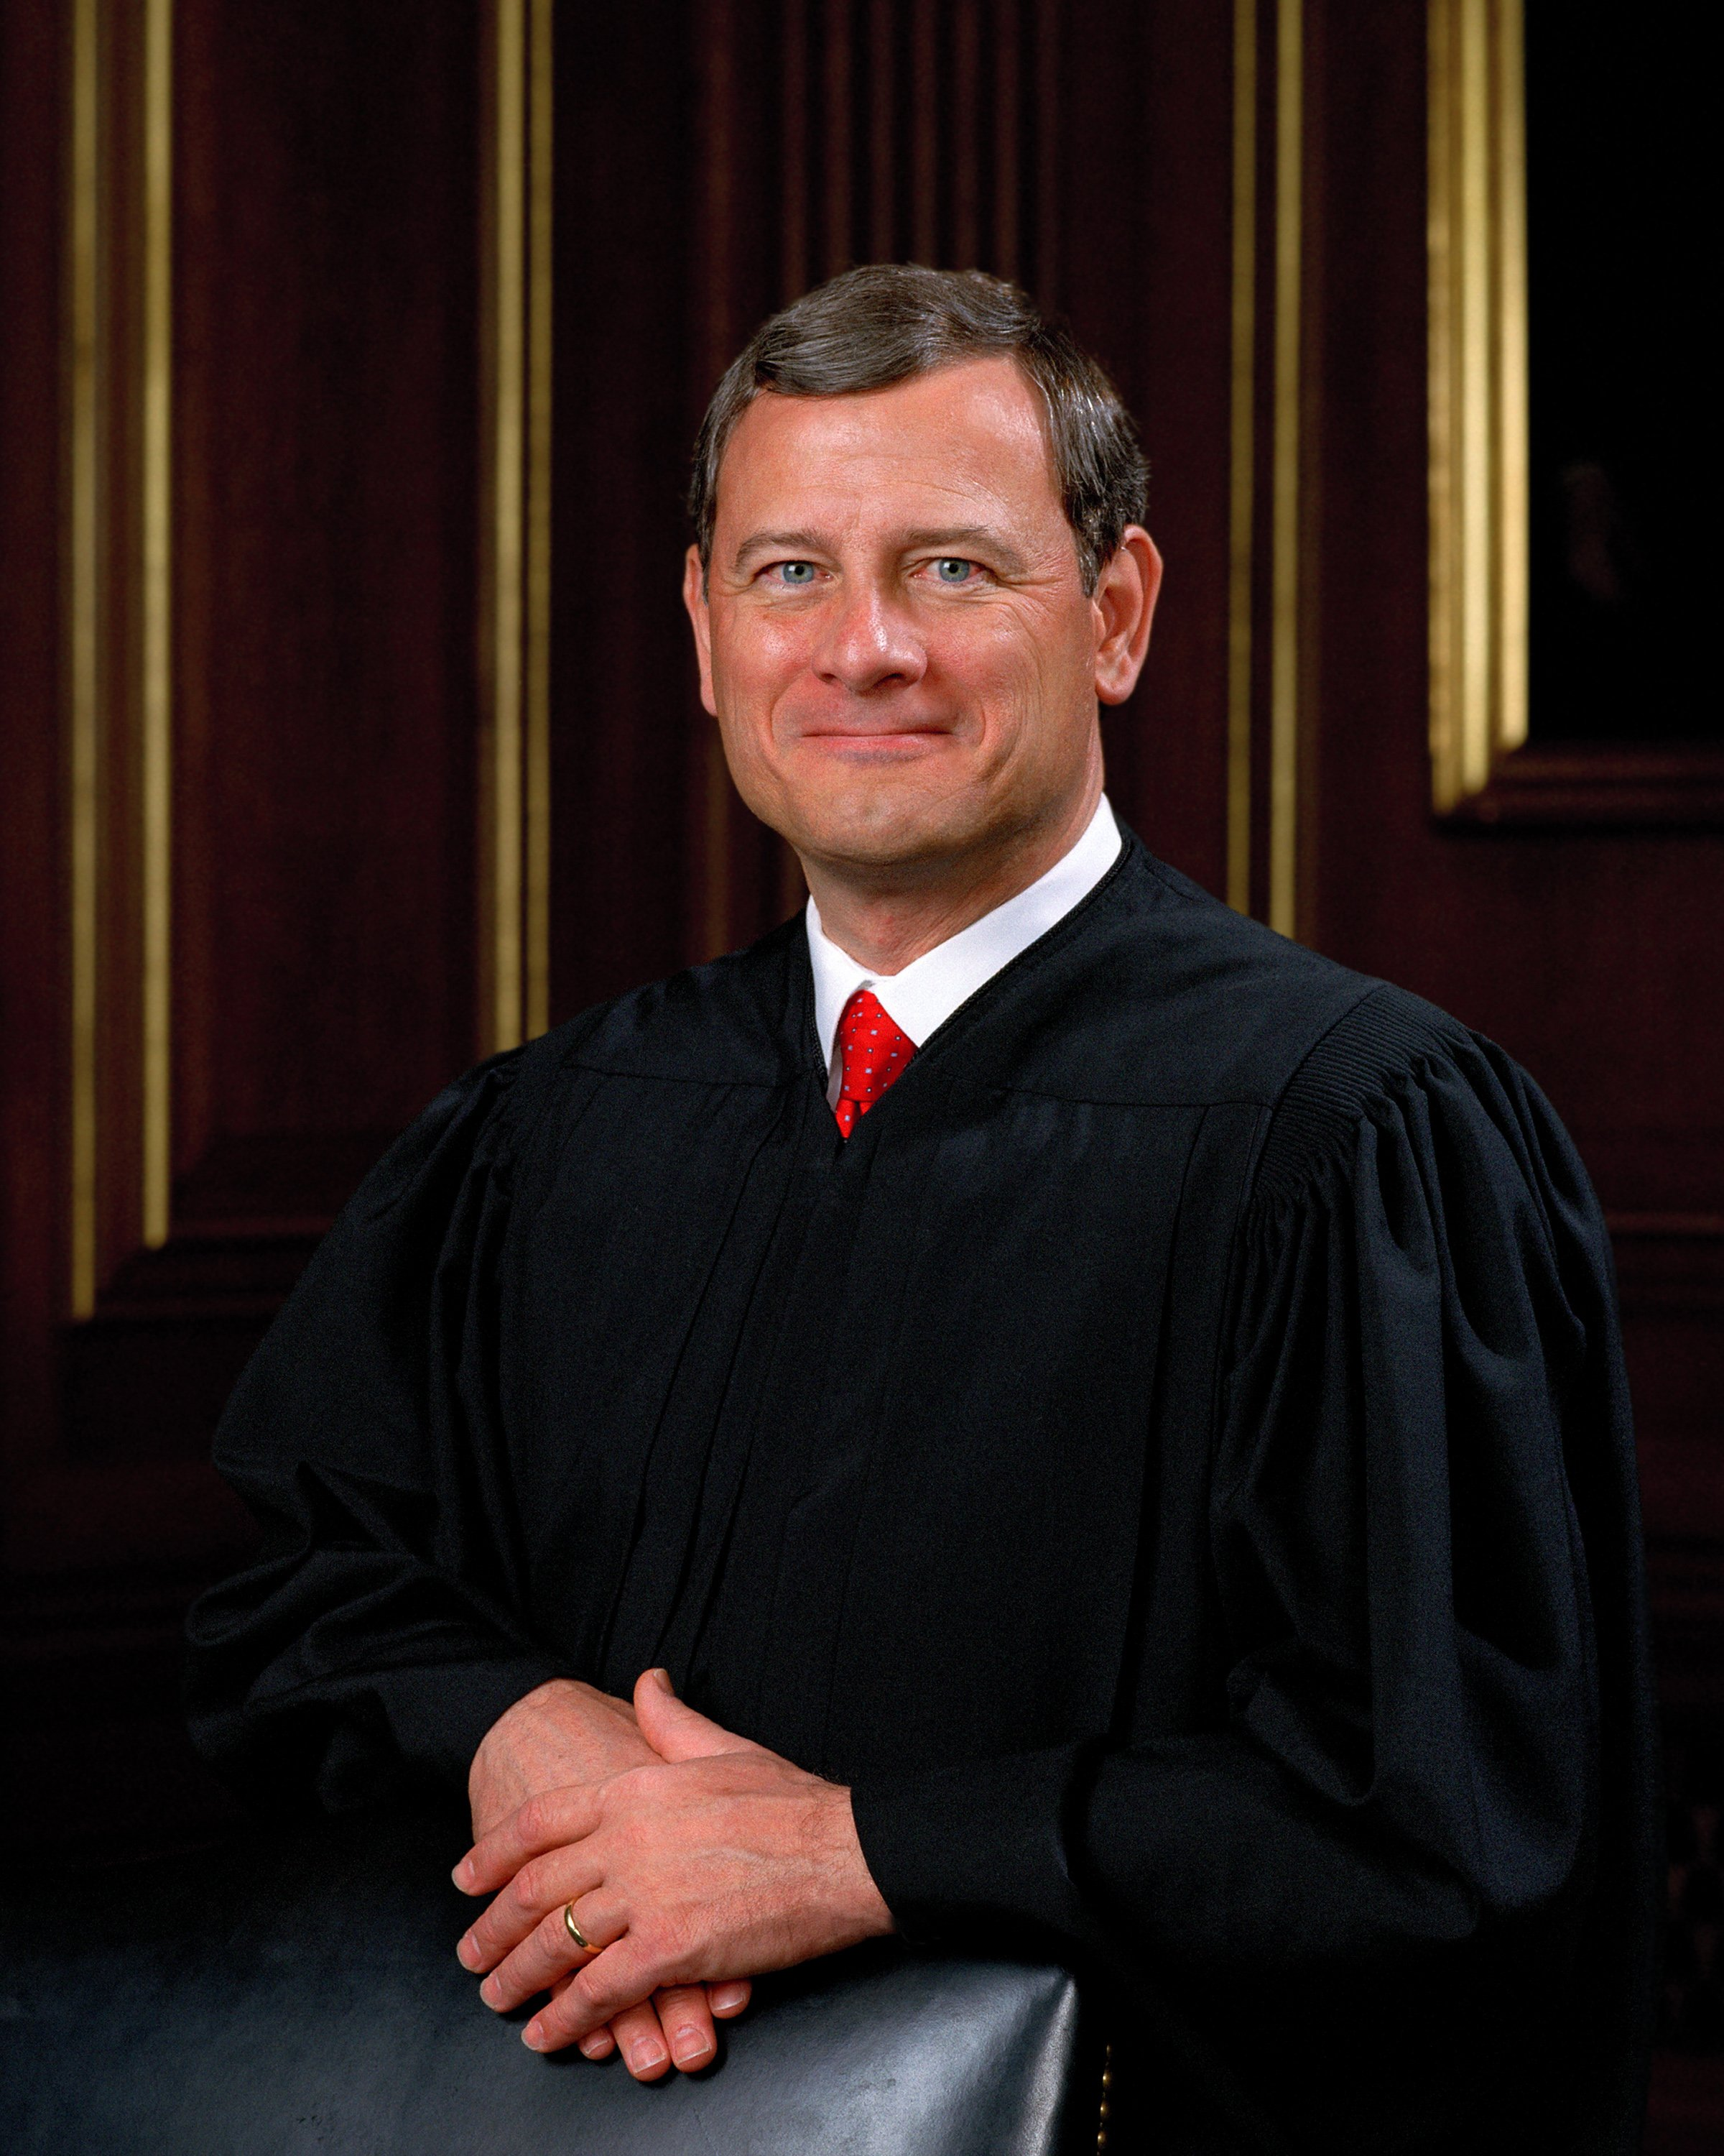
“Judges are like umpires. Umpires don’t make the rules; they apply them. The role of an umpire and a judge is critical. They make sure everybody plays by the rules. But it is a limited role. Nobody ever went to a ball game to see the umpire... I will remember that it’s my job to call balls and strikes and not to pitch or bat.”
Chief Justice John Roberts
“Questions of jurisdiction are questions of
power."
Benjamin Curtis,
Supreme Court Justice
600Commerce.com

Slide 4
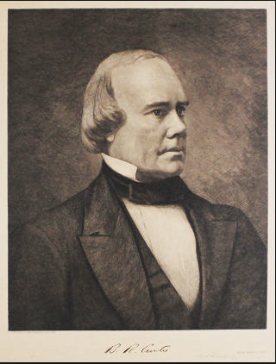
“Questions of jurisdiction are questions of
power."
Benjamin Curtis,
Supreme Court Justice
600Commerce.com

Slide 5
TEMPORARY
INJUNCTIONS
600Commerce.com

Slide 6

RWI Construction Co., v. Comerica Bank,
No. 05-18-00265-CV (April 12, 2019)
“[T]he ancient and controlling rule forecloses resort to injunctive relief simply to sequester a source of funds to satisfy a future judgment. That general rule would not control where there is a logical
and justifiable connection
between the claims alleged and
the acts sought to be enjoined,
or where the plaintiff claims
a specific contractual or
equitable interest in the
assets it seeks to freeze.”
600Commerce.com

Slide 7
MANDAMUS
600Commerce.com

Slide 8

In re Hines, 05-19-00243-CV
(April 15, 2019) (mem. op.)
“[R]elator’s certified mandamus
record includes copies of a motion
for judgment nunc pro tunc dated
August 24, 2018, and letter requests to the trial court dated September 27, 2018 and November 7, 2018 requesting a hearing on the August 24, 2018 motion for judgment nunc pro tunc. . . . Under this record, we conclude the trial court has violated its ministerial duty to rule on relator’s motion for judgment nunc pro tunc within a reasonable time.”
9-27-2018 → 200 days → 4-15-2019
600Commerce.com

Slide 9
Federal “Chase ‘must show not only that the district court erred’ ‘but that it clearly and indisputably erred’ in ordering that Arbitration Employees receive notice.” | State “A trial court has no ‘discretion’ in determining what the law is or applying the law to the facts.”
In re: JPMorgan Chase, 916 F.3d 494 (5th Cir. 2019) | Walker v. Packer, 827 S.W.2d 833 (Tex. 1992)
600Commerce.com

Slide 10
In re Yamaha Golf-Car Co.,
05-19-00292-CV (April 8, 2019) (mem. op.)
“Mandamus is unwarranted here because the principle of law Yamaha urged the trial court to follow is neither positively commanded nor plainly prescribed under the law.”
600Commerce.com

Slide 11
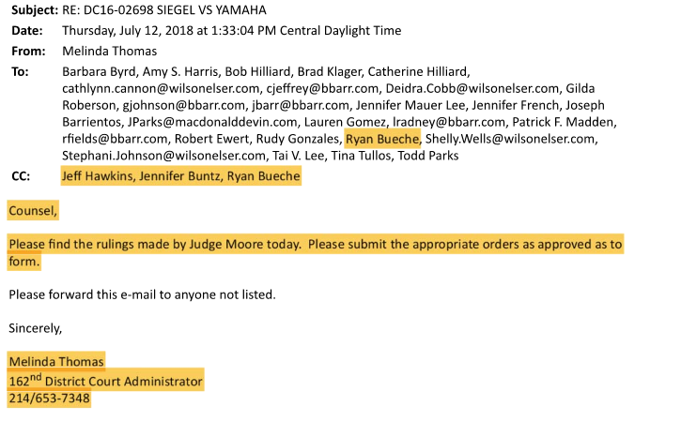
In re Yamaha Golf-Car Co.,
05-19-00292-CV (April 8, 2019) (mem. op.)
600Commerce.com

Slide 12
FORUM SELECTION
600Commerce.com

Slide 13
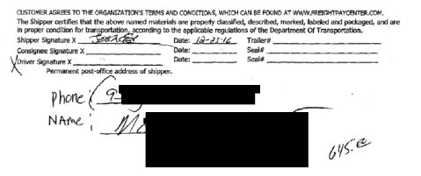
In re Freightquote.com, No. 05-18-01028-CV
(March 1, 2019) (mem. op.) (Myers, J., joined by Carlyle, J.)
“The bill of lading designated Amcad as ‘Shipper,’ RGV Logistics as ‘Carrier,’ and Amcad’s customer as ‘Consignee.’ The terms ‘Customer and ‘Organization’ were undefined.”
600Commerce.com

Slide 14

In re Freightquote.com, No. 05-18-01028-CV
(March 1, 2019) (mem. op.) (Myers, J., joined by Carlyle, J.)
“[T]he referring language is ambiguous
as to who agreed to which
Organization’s terms and
conditions and does not
unambiguously incorporate
by reference Freightquote’s
terms and conditions . . . .”
600Commerce.com

Slide 15
In re: Freightquote.com, No. 05-18-01028-CV
(March 1, 2019) (mem. op.) (Whitehill, J., dissenting)
“There was only one link and only one website specified for AMCAD to follow. AMCAD could not have gotten lost and ended up with a different set of terms and conditions by following that path. These facts and result are the same as if AMCAD agreed to be bound by a set of terms and conditions contained in a specific folder located on a specific desk in a specific AMCAD office.”
“[T]he parties plainly agreed to governing, written terms and conditions residing at a specific and readily accessible website”
600Commerce.com

Slide 16
SUMMMARY JUDGMENT
600Commerce.com

Slide 17

BCH Devel. v. Lakeview Heights Addition POA,
No. 05-17-010296 CV (March 21, 2019) (mem. op.)
“Waiver in restrictive covenant cases is a fact-intensive inquiry involving multiple factors. A statistical analysis is but one component in determining the issue of waiver.
Also relevant are the nature and
severity of existing violations,
any prior acts of enforcement of
the restriction, and whether it is still
possible to realize to a substantial
degree the benefits intended
through the covenant.”
600Commerce.com

Slide 18

TCPA
600Commerce.com

Slide 19
Dyer v. Medoc Health Services,
05-18-00472-CV (March 8, 2019)
Association. “Because the text messages between Basiti and Dyer were private communications related to an alleged conspiracy between the two men and did not involve public or citizen’s participation, it would be ‘illogical’ to apply the TCPA to those communications”
600Commerce.com

Slide 20
Dyer v. Medoc Health Services,
05-18-00472-CV (March 8, 2019)
Speech. “Basili and Dyer did not discuss any issue relating to health or any economic well-being (other than their own)
. . .
We cannot conclude communications discussing allegedly tortious conduct are tangentially related to a matter of public concern simply because the proprietary and confidential information that was to be misappropriated belonged to a company in the healthcare industry or because the alleged tortfeasors hoped to profit from their conduct.”
600Commerce.com

Slide 21
Dyer v. Medoc Health Services,
05-18-00472-CV (March 8, 2019)
Petition. “However, even assuming Dyer’s actions, and the communications relating to those actions, were ‘petitioning’ activities as defined by the TCPA, appellants failed to establish appellees’ claims were based on, related to, or in response to any communications between Dyer and any other person about the FBI investigation or on Dyer’s providing appellees’ proprietary software and confidential information to the FBI.”
600Commerce.com

Slide 22

Silence. “The basis of Tactical’s claims against Krasnicki rests solely on its assertion that Krasnicki failed to communicate with Tactical.” Krasnicki v. Tactical Entertainment, No. 05-18-00463-CV (May 16, 2019).
Plaintiff’s speech. “[T]he TCPA applies only if the plaintiff’s lawsuit is based on, relates to, or is in response to the defendant’s . . . exercise of one of the protected rights.” motion to dismiss the legal action.” Encore Enterprises, Inc. v. Shetty, No. 05-18-00511-CV (April 29, 2019) (mem. op.)
“Related to.” “[T]he communications
at issue here involve . . . Statements
about a business dispute, the subject
of which involves physicians . . . .”
Staff Care v. Eskridge Enterprises,
No. 05-18-00732-CV (May 15, 2019)
(mem. op.)
600Commerce.com

Slide 23
Erdner v. Highland Park Emergency Center,
No. 05-18-00654-CV (May 22, 2019)
(Molberg, J., joined by Reichek, J.)
“[T]hose communications involved, at most, the potential formation of a company that might, in the future, have the resources to acquire the right to build an [emergency-care facility] somewhere in a general area.”
600Commerce.com

Slide 24
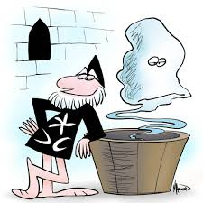
Erdner v. Highland Park Emergency Center,
No. 05-18-00654-CV (May 22, 2019)
(Whitehill, J., dissenting)
“[T]angential is a common word that conjures wispiness.”
600Commerce.com

Slide 25
ARBITRATION
600Commerce.com

Slide 26
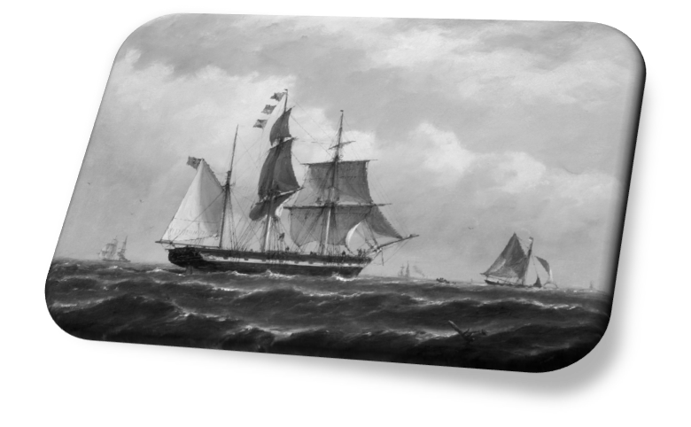
SIG-TX Assets, LLC v. Serrato,
No. 05-18-00462-CV (April 23, 2019)
(Partida-Kipness, J., joined by Carlyle, J.)
“[A]though SIG-TX’s duty to prepare and inter Maria’s body arose from the contracts, there is an independent duty under Texas tort law to immediate family
[m]embers not to
negligently
mishandle a
corpse.”
600Commerce.com

Slide 27
SIG-TX Assets, LLC v. Serrato, No. 05-18-00462-CV
(April 23, 2019) (Bridges, J., dissenting)
“Beatrice and the other appellees obtained substantial actions from SIG-TX by demanding compliance with provisions of the contracts . . . .”
“[T]he Weekley court
acknowledged a contractor
. . . had ‘an independent
duty under Texas tort law
not to injure bystanders
by its activities’ . . . .”
600Commerce.com

Slide 28

TODAY OR TOMORROW?
600Commerce.com

Slide 29

Phillips v. Clark, No. 05-18-00556-CV (May 3, 2019)
(Reichek, J., joined by Molberg, J.)
“The record before us shows that Phillips was a candidate for public office . . . . Nothing in the record shows Phillips has ever engaged in professional news reporting or any other form of journalism or professional investigation and
commentary about matters of
public concern. Accordingly,
Phillips does not qualify as a
‘member of the media’. . . .”
600Commerce.com

Slide 30

Phillips v. Clark, No. 05-18-00556-CV (May 3, 2019).
(Whitehill, J., dissenting)
“Because there is a straight-
forward answer to this case
without exploring in the first
instance the boundaries of what
constitutes the electronic media,
we should follow the straightforward
path and wait until when defining
the electronic media is necessary
to decide the case then before us.”
600Commerce.com

Slide 31

“I think it useless and undesirable, as a rule, to express dissent . . . .”
Northern Sec. Co. v. United States, 193 U.S. 197, 400 (1904)
(Oliver Wendell Holmes, Jr., dissenting).
“A dissent in a court of last resort is an appeal to the brooding spirit of the law, to the intelligence of a future day, when a later decision may possibly correct the error into which the dissenting judge believes the court to have been betrayed.”
Charles Evans Hughes,
The Supreme Court of the
United States 68 (1928)
600Commerce.com

Slide 32

“Questions of jurisdiction are questions of
power."
Benjamin Curtis,
Supreme Court Justice
600Commerce.com

Slide 33
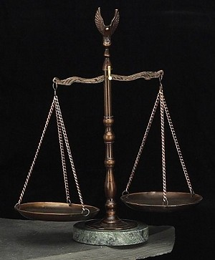
Temporary Injunction
Public – Private
Mandamus
Appellate – Trial Court
Forum Selection
Court Rules – Contract
TCPA
Court – Jury
Arbitration
Court – Contract

Slide 34
DALLAS COMMERCIAL
CASES 2019
DAVID S. COALE
DBA Appellate Law Section Meeting
Dallas, Texas
June 13, 2019
600Commerce.com

